Slide 1
IO and Networking
Author & Presenter -Asfiya Khan (Senior Technical Trainer)

Slide 2
Agenda
Concept of Streams
Binary Stream Vs Character Stream
File – Reading and Writing
Stream Layering and Handling Primitive Data
Serialization and De-Serialization
New File System API (NIO)
Networking
TCP/IP Sockets

Slide 3
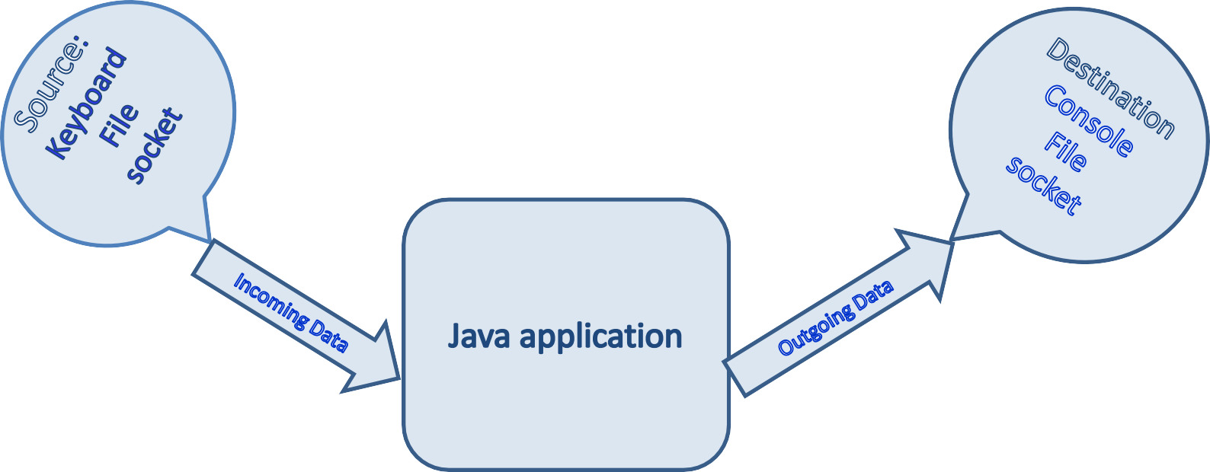
Concept Of Streams
Input Stream: read()
Output Stream: write()
Flow of data is depicted as Stream
Input Stream : Flow of data from a source to java application Output Stream: Flow of data from application to some destination

Slide 4
Concept Of Streams
I/O Fundamentals
A stream can be thought of as a flow of data from a
source or to a sink.
A source stream initiates the flow of data, also called an input stream.
A sink stream terminates the flow of data, also called an output stream.
Sources and sinks are both node streams.

Slide 5
Binary Stream Vs Character Stream
Two Major Hierarchies in Java:
Binary Stream (Data in Binary mode)
Character Stream (Data in Text mode)
Java technology supports two types of streams:
character and byte.
Input and output of character data is handled by
readers and writers.
Input and output of byte data is handled by
Input streams and output streams:
Normally, the term stream refers to a byte stream.
The terms reader and writer refer to character streams.

Slide 6
InputStream and OutputStream Methods
The InputStream Methods:
The three basic read methods are:
int read()
int read(byte[] buffer)
int read(byte[] buffer, int offset, int length)
The OutputStream Methods:
The three basic write methods are:
void write(int c)
void write(byte[] buffer)
void write(byte[] buffer, int offset, int length)
Other methods include: void close()
void flush()

Slide 7
Reader and Writer Methods
The Reader Methods
The three basic read methods are:
int read()
int read(char[] cbuf)
int read(char[] cbuf, int offset, int length)
The Writer Methods
The basic write methods are:
void write(int c)
void write(char[] cbuf)
void write(char[] cbuf, int offset, int length)
void write(String string)
void write(String string, int offset, int length)
Other methods include:
void close() void flush()

Slide 8
File Stream I/O
File Stream I/O
For file input:
Use the FileReader class to read characters.
Use the BufferedReader class to use the readLine method.
For file output:
Use the FileWriter class to write characters.
Use the PrintWriter class to use the print and println methods.

Slide 9
File – Reading and Writing
The java.io package enables you to do the following steps:
•
•
•
Create File objects Manipulate File objects
Read and write to file streams

Slide 10
Standard Streams
Standard Streams : feature provided by many operating
systems.
By default, they read input from the keyboard
write output to display.
They also support I/O operations on files.
System.in
: used to read input from the keyboard.
System. out : used to write output to display.
System. err : used to write error output

Slide 11
System.in is a byte stream that has no character stream features.
Standard Streams Cont.…
To use Standard Input as a character stream, wrap System.in within the InputStreamReader as an argument.
InputStreamReader inp = new InputStreamReader(system.in);

Slide 12
Stream Layering & Handling Primitive Data
Apart from Binary or Text mode, data can also be read or written in
primitive data type format like : int ,float ..
DataInput & DataOutput Streams are provided for this purpose.
If you want to read or write primitive data to file then, choose appropriate File Stream object & Enwrap it into DataStream object.
This is known as enlayering.
Methods in DataInputStream: readInt() ,readFloat() ,readUTF()…. Methods in DataOutputStream: writeInt() ,writeFloat() , writeUTF()….

Slide 13
Layering Demo
public static void main(String[] args) throws IOException {
DataOutputStream dos=new DataOutputStream(new FileOutputStream("MyData"));
dos.writeInt(1); dos.writeFloat(2.2f); dos.writeUTF("hi");
DataInputStream dis=new DataInputStream(new FileInputStream("MyData"));
System.out.println(dis.readInt()); System.out.println(dis.readFloat()); System.out.println(dis.readUTF()); }

Slide 14
Serialization and De-Serialization
Java supports Persistence
The state of Java Objects can be stored permanently (to some file….) Advantage: Future Reuse.
Serialization & Deserialization :
It is the process of saving an object's state to a sequence of bytes
&
the process of rebuilding those bytes into a live object at some future time
Streams & methods provided:
ObjectOutputStream : writeObject() ………..
ObjectInputStream : readObject() ……….
Serialization
Deserialization

Slide 15
Serializable : A tagging interface
We need to implement Serializable interface to a class Object which we need to persist.
Object Serialization is not possible if class does not implement Serializable interface.
In such case, NotSerializableException will be thrown.

Slide 16
New File System API –NIO 2.0
Those who worked with Java IO may still remember the headaches that framework caused. It was never easy to work seamlessly across operating systems or multi-file systems. There were methods such as delete or rename that behaved unexpected in most cases. Working with symbolic links was another issue.
With the intention of solving the above problems with Java IO, Java 7 introduced an overhauled and in many cases new API.
The NIO 2.0 has come forward with many enhancements. It’s also introduced new classes to ease the life of a developer when working with multiple file systems.

Slide 17
Working With Path
A new java.nio.file package consists of classes and interfaces such as Path, Paths, FileSystem,FileSystems and others.
A Path is simply a reference to a file path. It is the equivalent (and with more features) to java.io.File. The following snippet shows how to obtain a path reference to the “temp” folder:
public voidpathInfo() {
Path path= Paths.get("c:\Temp\temp");
System.out.println("Number of Nodes:"+ path.getNameCount()); System.out.println("File Name:"+ path.getFileName()); System.out.println("File Root:"+ path.getRoot()); System.out.println("File Parent:"+ path.getParent());
}

Slide 18
Files In NIO
Deleting a file or directory is as simple as invoking a delete method on Files (note the plural) class. The Files class exposes two delete methods, one that throws NoSuchFileException and the other that does not.
The following delete method invocation throws NoSuchFileException, so you have to handle it:
Files.delete(path);
Where as Files.deleteIfExists(path) does not throw exception (as expected) if the file/directory does not exist.
You can use other utility methods such as Files.copy(..) and Files.move(..) to act on a file system efficiently. Similarly, use the createSymbolicLink(..) method to create symbolic links using your code.

Slide 19
NIO 2.0 Enhancement – File System Change Notification
File System Change Notification
The java.nio.file package has a WatchService API to support file change notification.
User can register directory/directories to watch and specify type of events to monitor. Various types of events are -
ENTRY_CREATE - A directory entry is created.
ENTRY_DELETE - A directory entry is deleted. ENTRY_MODIFY - A directory entry is modified.
OVERFLOW - Indicates that events might have been lost or discarded. You do not have to register for the OVERFLOW event to receive it.
Once the event occurs, it is forwarded to registered process which is
thread or pool of threads for handling the event.

Slide 20
NIO 2.0 Enhancement – File System Change Notification
FileSystem fileSystem = FileSystems.getDefault() WatchService wService = fileSystem.newWatchService(); Path dir = ...;
try {
dir.register(wService, ENTRY_CREATE, ENTRY_DELETE);
WatchKey key = wService.take(); //or wService.poll();
:
} catch (IOException x) { System.err.println(x);
}
First step is to create WatchService using FileSystem.newWatchService() method.
Next step is to registered instance of WatchService with object that implements Watchable interface. Java.nio.file.Path implement Watchable interface.
WatchService has methods take(), poll() and close()

Slide 21
NIO 2.0 Enhancement – File System Change Notification
for (;;) {
WatchKey key = watcher.take();
for (WatchEvent event : key.pollEvents()) { String file = object.context().toString(); if (event.kind() == ENTRY_DELETE) {
System.out.println("Delete: " + file);
} if (event.kind() == ENTRY_CREATE) { System.out.println("Created: " + file);
}
}
}
Infinite for loop waits for incoming events. When event occurs key is signaled and place into watcher queue.
Inner for loop retrieves pending events for the WatchKey & process as needed.
Reset key and resume waiting for the events.

Slide 22
Networking
The Internet is all about connecting machines together.
One of the most exciting aspects of Java is that it incorporates an easy-to- use, cross-platform model for network communications.

Slide 23
The Internet Protocol breaks all communications into packets, finite- sized chunks of data which are separately and individually routed from source to destination.
Socket is an abstraction that is provided to an application programmer to send or receive data to another process.
Data can be sent to or received from another process running on the same machine or a different machine.
Sockets

Slide 24
Sockets Contd..
Socket is a combination of IP Address & Port number
A port number is a logical no. assigned to a process to identify it on a given system
Port number up to 1024 are reserved port numbers. Also known as well- known ports.

Slide 25
TCP/IP
•
Transmission Control Protocol, TCP, establishes a connection between
the two endpoints.
The socket remains open throughout the duration of the communications.
TCP is responsible for
breaking the data into packets,
buffering the data,
resending lost or out of order packets,
-acknowledging receipt,
-controlling rate of data flow.

Slide 26
You can use the Java language to communicate with remote file systems
using a client/server model.
A server listens for connection requests from clients across the network or even from the same machine.
Clients know how to connect to the server via an IP address and port number.
Client Server Computing
Response
Client
Server
Request

Slide 27
Client Server Computing Contd..
Creating TCP Clients
To create a TCP client, do the following:
Create a Socket object attached to a remote host, port.
Socket client = new Socket(host, port);
When the constructor returns, you have a connection.
3. Get input and output streams associated with the socket.

Slide 28
Client Server Computing Contd..
Creating TCP Servers
To create a TCP server, do the following:
Create a ServerSocket attached to a port number. ServerSocket server = new ServerSocket(port);
Wait for connections from clients requesting connections to that port.
Socket channel = server.accept();
You'll get a Socket object as a result of the connection.
Get input and output streams associated with the socket.

Slide 29
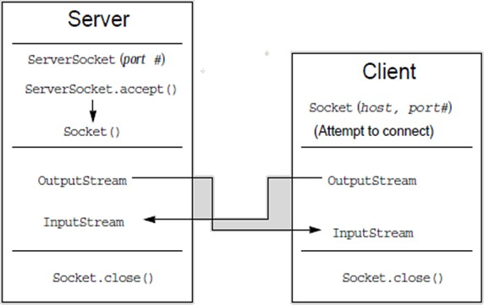
Client Server Computing Contd..

Slide 30
Client Server Computing Contd..
Client must contact server:
server process must first be running.
server must have created socket (door) that welcomes client’s contact.
Client contacts server by:
creating client-local TCP socket.
specifying IP address, port number of server process.
When client creates socket: client TCP establishes connection to server TCP.
When contacted by client, server TCP creates new socket for server process to communicate with client and allows server to talk with multiple clients on the basis of source port numbers.

Slide 31
Java TCP Socket Programming
Part of the java.net package
import java.net.*;
Provides two classes of sockets for TCP
Socket – client side of socket
ServerSocket – server side of socket

Slide 32
Java TCP Socket Programming
ServerSocket performs functions bind and listen
Bind – fix to a certain port number
Listen – wait for incoming requests on the port
Socket performs function connect
Connect – begin TCP session

Slide 33


Slide 34


Thank You!
Any Questions ?
9/4/2019
www.cybage.com
Copyright © 2019 Cybage Software Pvt. Ltd. All Rights Reserved. Cybage Confidential.

